Slide 1
Illumination Model
Dr. Sk. Mohammad Masudul Ahsan
&
S. M. Taslim Uddin Raju

Slide 2
What You’ll See Today
Lighting Principles
Illumination Model
Ambient
Diffuse
Specular

Slide 3
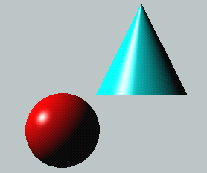
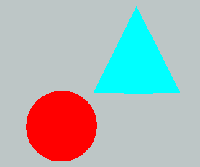
Lighting Principles
Lighting simulates how objects reflect light
material composition of object
light’s color and position
global lighting parameters
ambient light
two sided lighting
available in both color index and RGBA mode

Slide 4

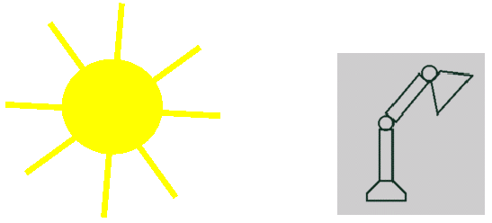
Light Source Model
Simple Mathematical Models:
Point light
Directional light
Spot light

Slide 5
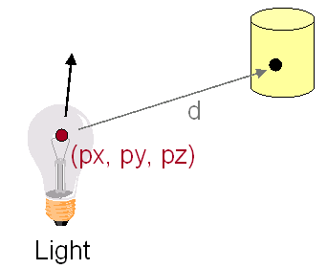
Point Light Source
Models Omni-Directional Point Source (E.g., Bulb)
Intensity (I₀)
Position (px, py, pz)
Factors (k_{c}, k_{l}, k_{q}) for attenuation with distance (d)

Slide 6
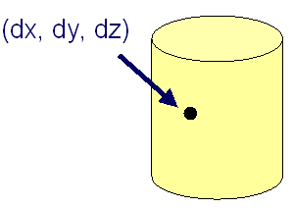
Directional Light Source
Models Point Light Source at Infinity (E.g., Sun)
Intensity (I₀)
Direction (dx,dy,dz)
No attenuation
with distance

Slide 7
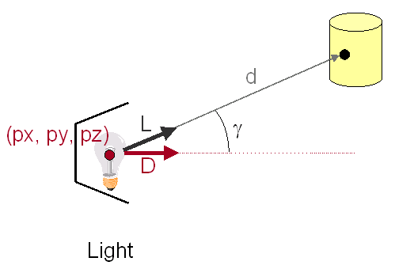
Spot Light Source
Models Point Light Source with Direction (E.g., Luxo)
Intensity (I₀)
Position (px, py, pz)
Direction (dx, dy, dz)
Attenuation

Slide 8
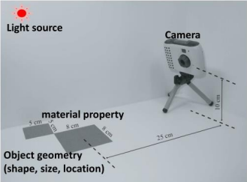
Illumination Model
How to compute color to represent a scene
As in taking a photo in real life:
Camera
Lighting
Object
Geometry
Material
Illumination model:
Combine all to produce a color Light source

Slide 9
Illumination Model
An object is illuminated from ambient light and from interrelated light source.
The important components are:
Ambient Light
Diffuse Refection
Specular Reflection
Global Illumination = Ambient Light + Diffuse Light + Specular Light + Emissive Light

Slide 10
Ambient Light
Also called background light
General level of illumination that does not come directly from a light source
Consists of light that has been reflected and re-reflected so many times
When ambient light strikes a surface, it's scattered equally in all directions.
Its direction is impossible to determine

Slide 11
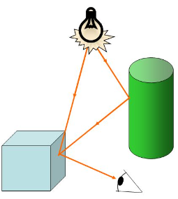
Ambient Light
Light from environment
Light reflected or scattered from other objects
Coming uniformly from all directions and then reflected equally to all directions.

Slide 12
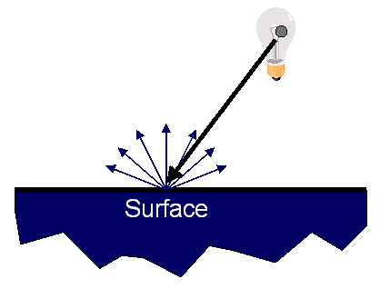
Diffuse Reflection
Light that comes from one direction
Light scattered with equal intensity in all directions (ideal diffuse reflection)

Slide 13
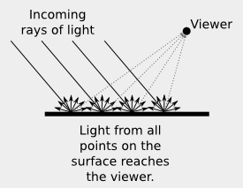
Diffuse Reflection
Light from a point is independent on viewing direction (equally bright in all directions)
Once it hits a surface, however, it's scattered equally in all directions, so it appears equally bright, no matter where the eye is located.

Slide 14
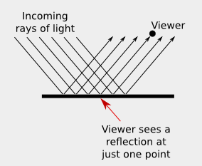
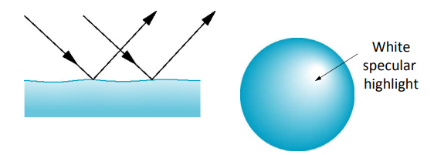
Specular Reflection
Light comes from a particular direction, and it tends to bounce off the surface in a preferred direction.
Depends on angle of incident light and angle to viewer
Intensity depends on where the viewer is!

Slide 15
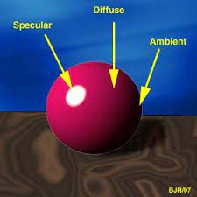
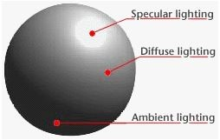
At a glance

